Slide 1
Object Detection
Deep Learning and Image Processing

Slide 2
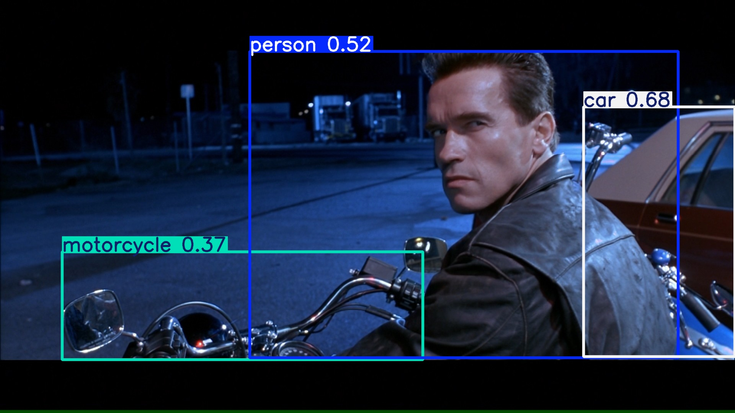
output: bounding boxes with category label and confidence

Slide 3
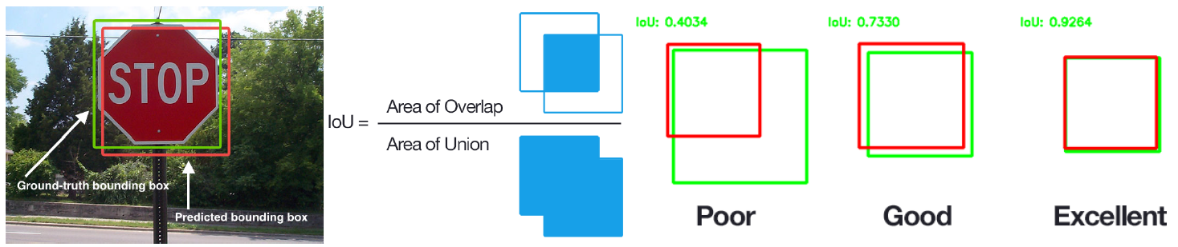
Performance Evaluation of Localization
Intersection-over-Union
images with multiple objects: number of detections dependent on used confidence threshold

Slide 4
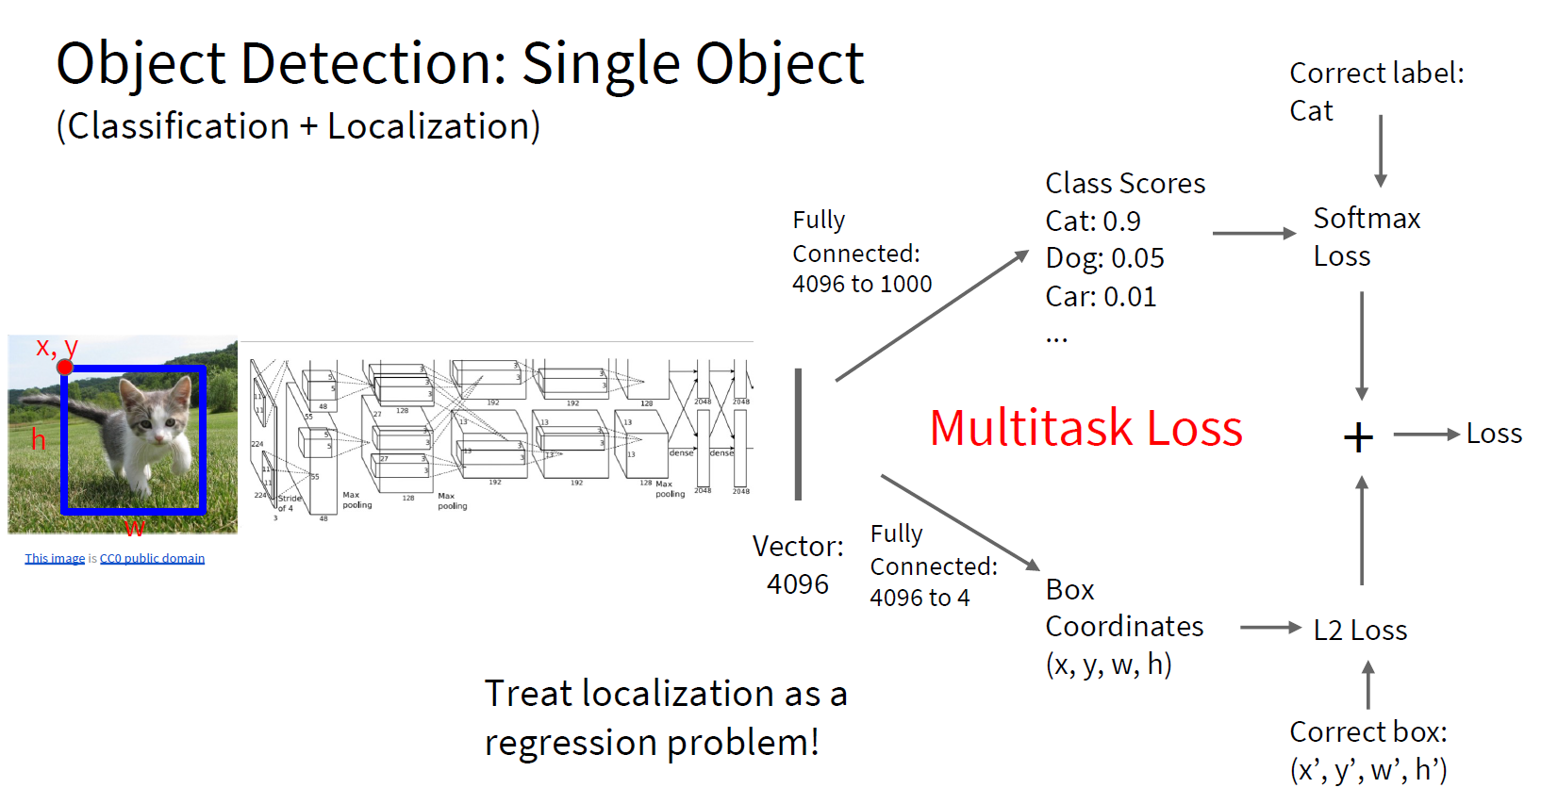
too complicated for multiple objects

Slide 5
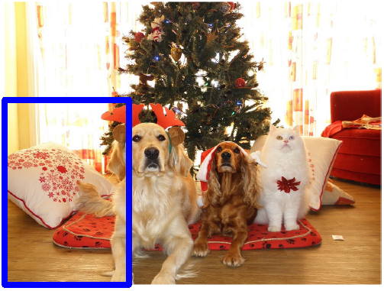
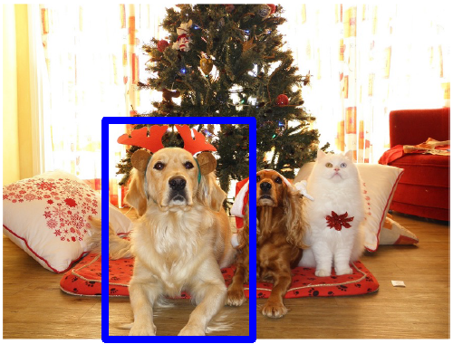
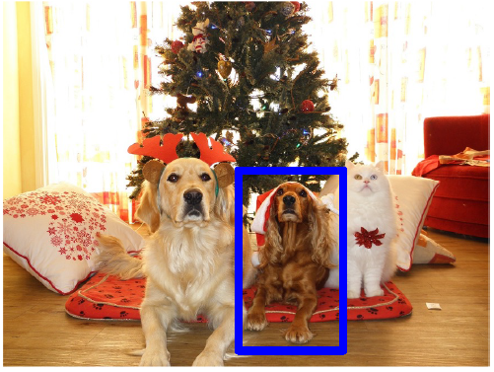
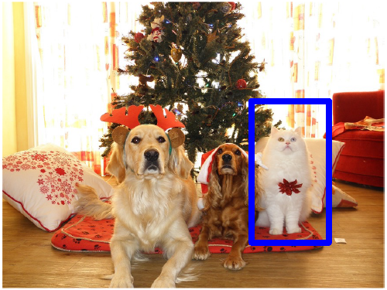
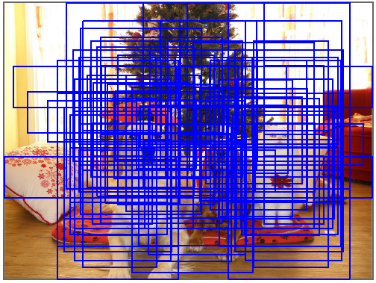
Localization for Multiple-Object Images
idea: classify many different crops of the image as object or background
(crops: sliding window over image, iterated at multiple window sizes)
Dog? No
Cat? No
Background? Yes
Dog? Yes
Cat? No
Background? No
Dog? Yes
Cat? No
Background? No
Dog? No
Cat? Yes
Background? No
issue: too many possible crops
→ need for region proposals

Slide 6
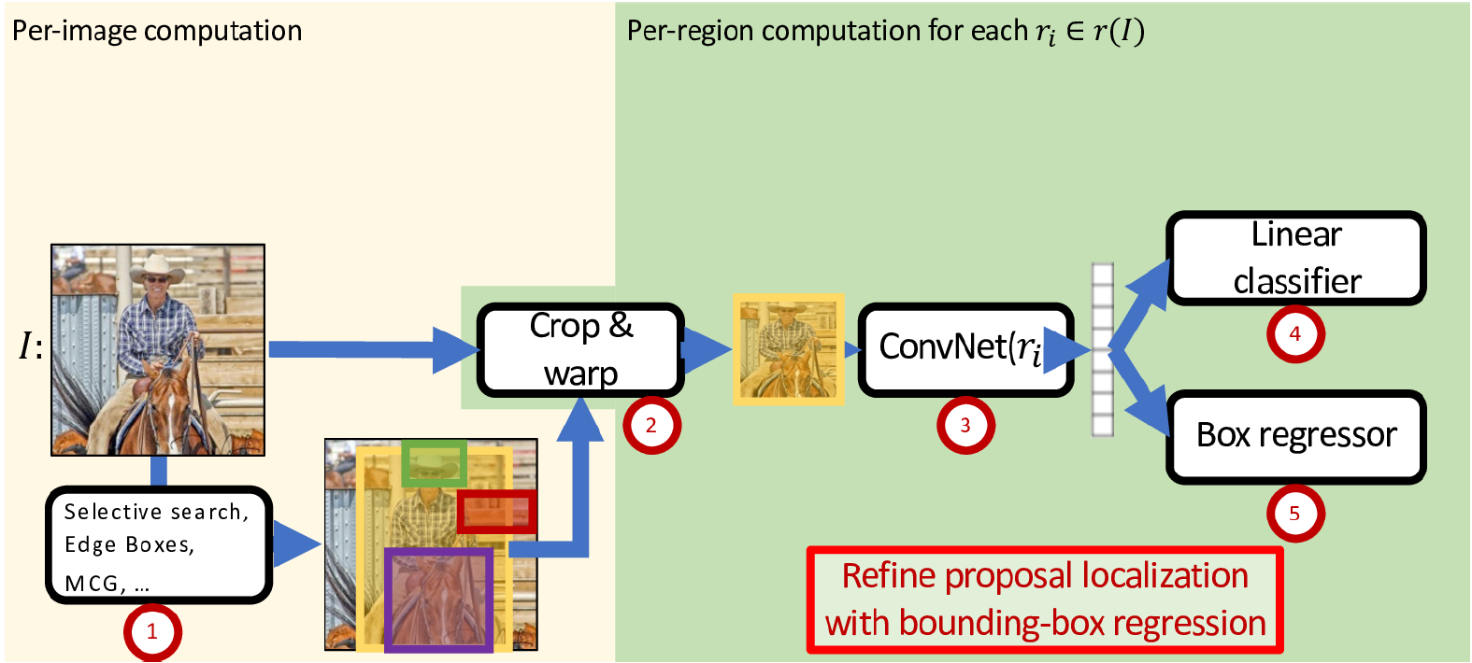

Region-Based Convolutional Neural Network (R-CNN)
task-specific heads:
two stages
object classification
feature representation
(forward-pass through pretrained CNN)
bounding-box refinement
region proposals by “classic” method (~2k)

Slide 7
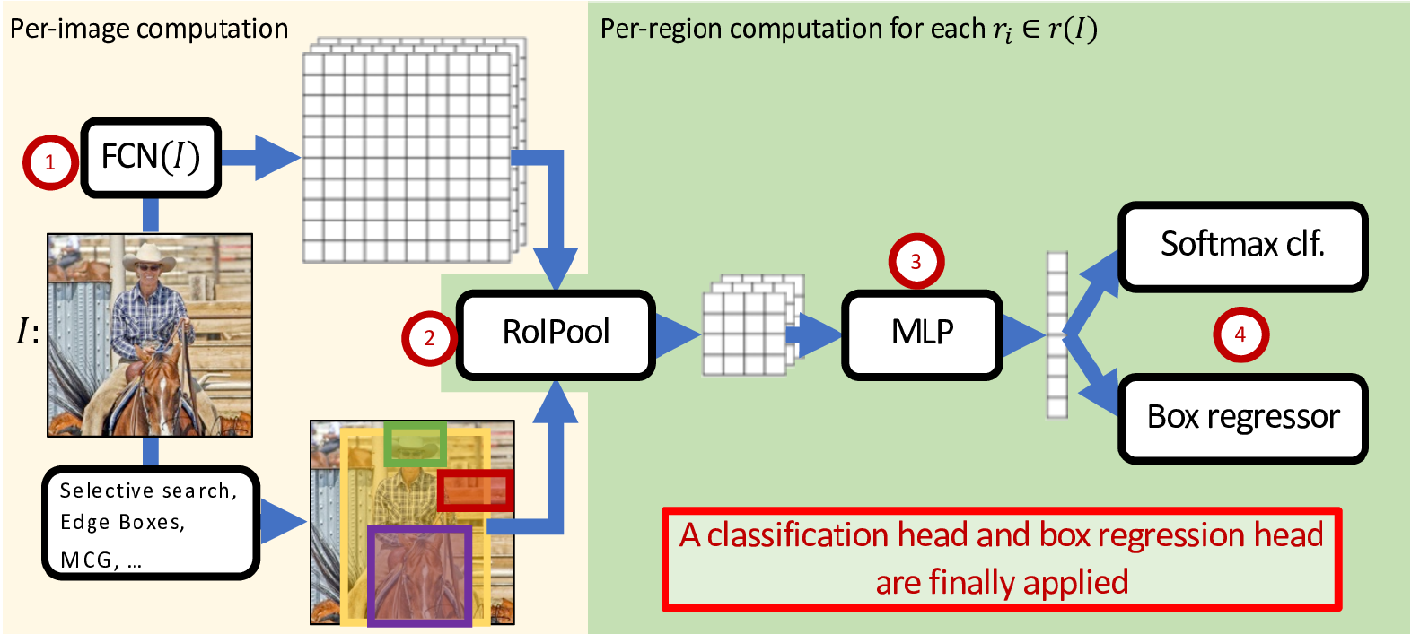
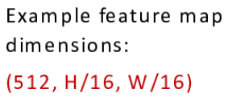
Fast R-CNN: Crop ConvNet Features
Fully Convolutional Network
(pretrained)
feature sharing
end-to-end trainable
fixed-dimensional representation
Region of Interest pooling
or CNN
more lightweight

Slide 8
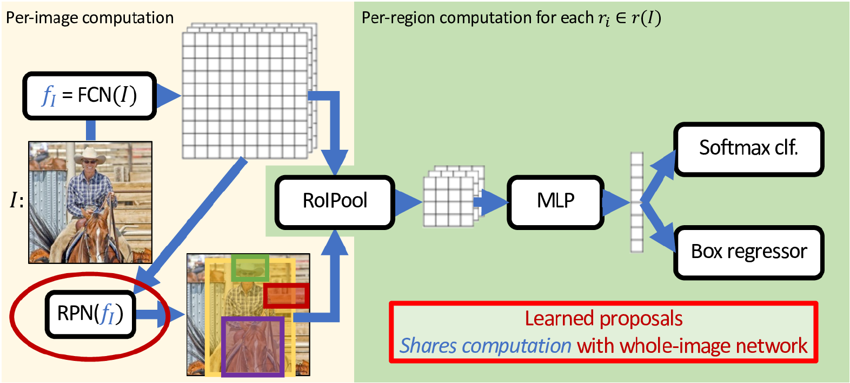
Faster R-CNN: Use Region Proposal Network
binary classification (object or not) with sliding window

Slide 9
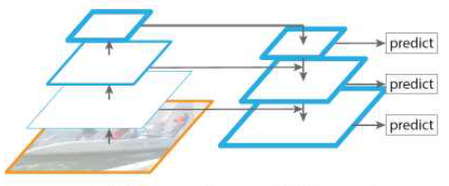
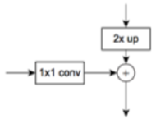
Feature Pyramid Network (FPN)

Slide 10
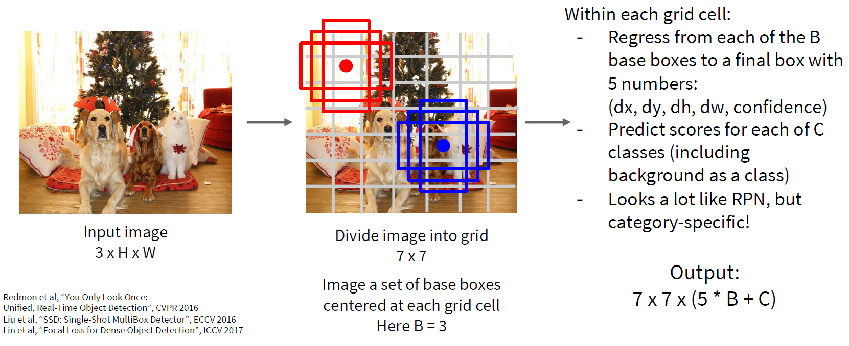
Single-Stage Detectors: Drop Per-Region Computation
faster, but usually worse performance

Slide 11
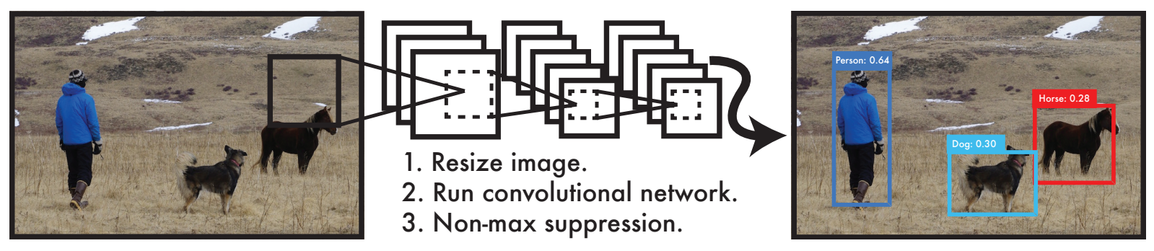
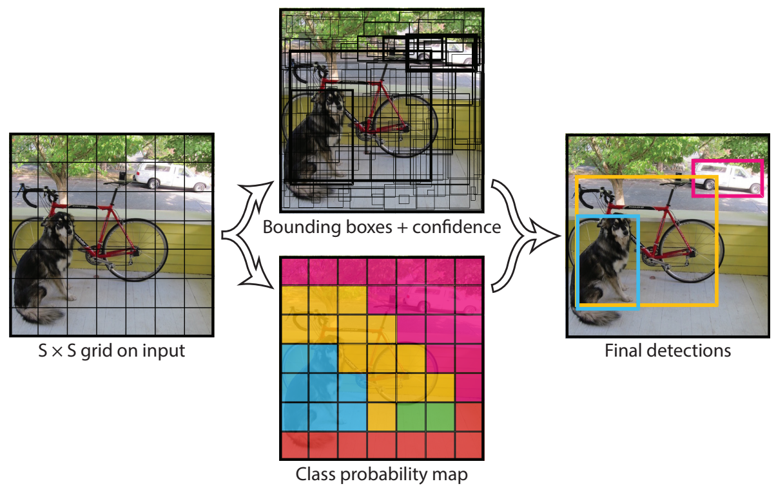
YOLO: Real-Time Object Detection
You Only Look Once:
prediction of bounding boxes and class probabilities in one go

Slide 12
Object Tracking
task: locating an object in successive video frames
basic approach:
detection: localize target object(s) (e.g., YOLO)
motion estimation: predict next location (e.g., Kalman filter or optical flow)
appearance matching: comparison of previous and predicted next location (e.g., feature descriptor, CNN features)
detection repeated frequently to correct for accumulated deviations

Slide 13
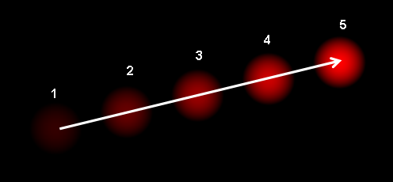
Optical Flow
dense optical flow:
estimate motion vector of every pixel
e.g., Horn-Schunck method or Lucas-Kanade (LK) method
sparse optical flow:
estimate motion vector of few image features
e.g., Kanade-Lucas-Tomasi (KLT) feature tracker

Slide 14
Instance Segmentation

Slide 15
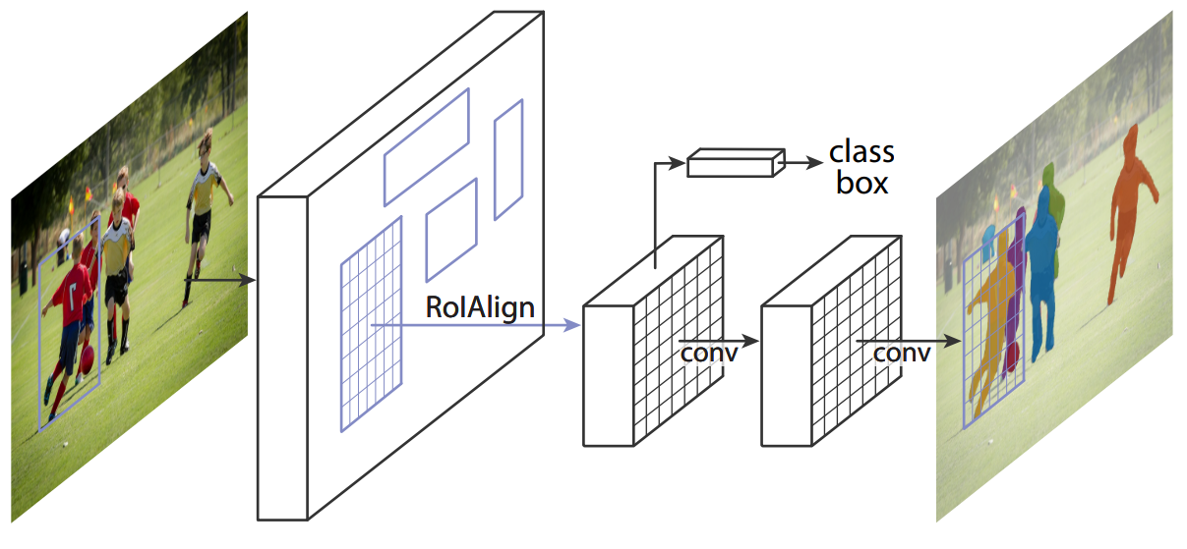
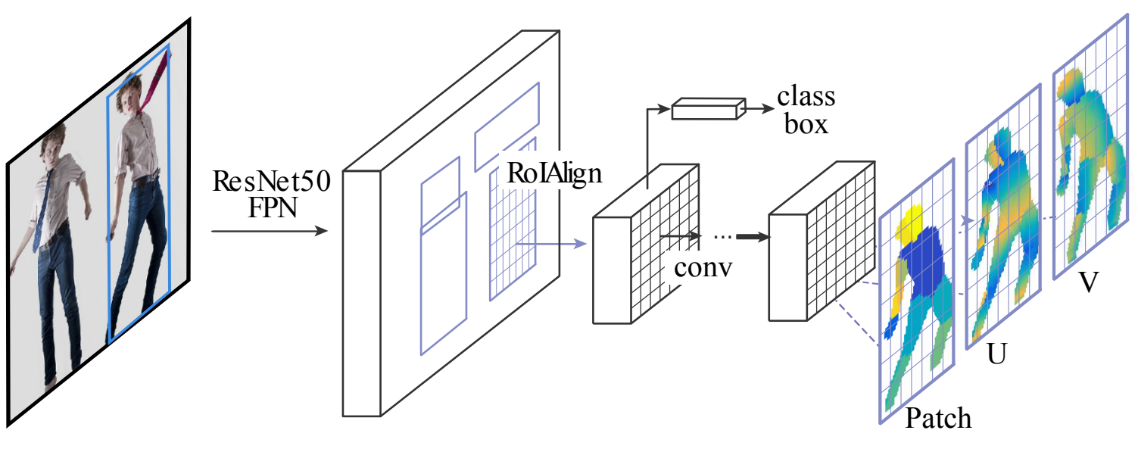
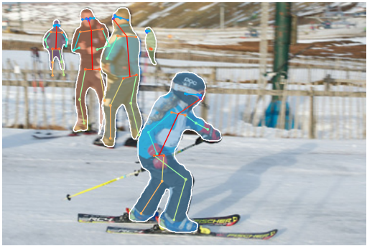
Add Additional Network Heads to R-CNN
instance segmentation (Mask R-CNN):
pose estimation (DensePose):
3D model’s surface to 2D

Slide 16
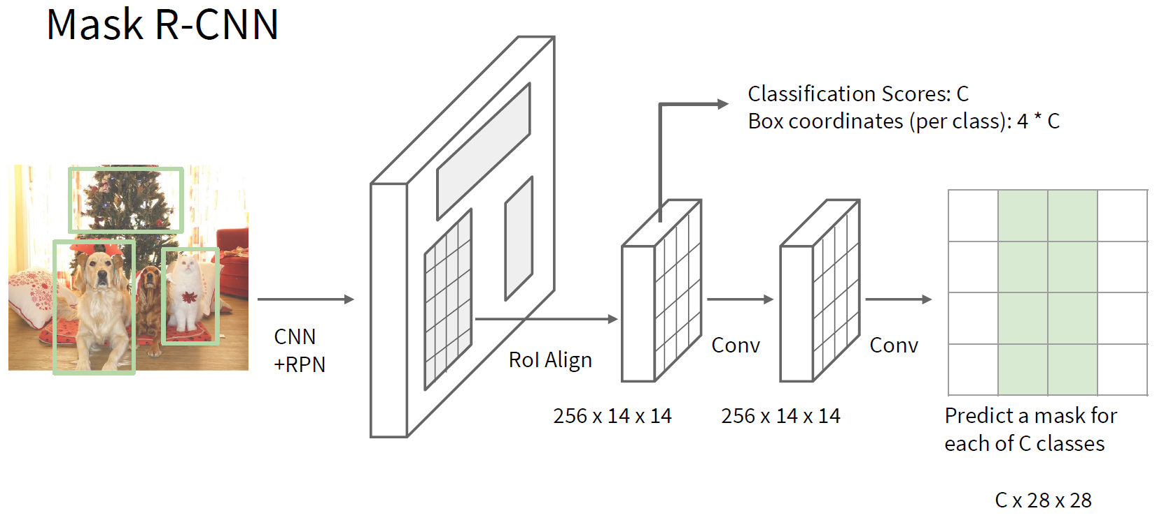
Faster R-CNN

Slide 17
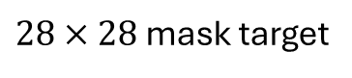
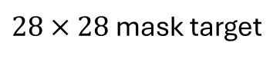
image with training proposal
$28×28$ mask target
image with training proposal
$28×28$ mask target

Slide 18
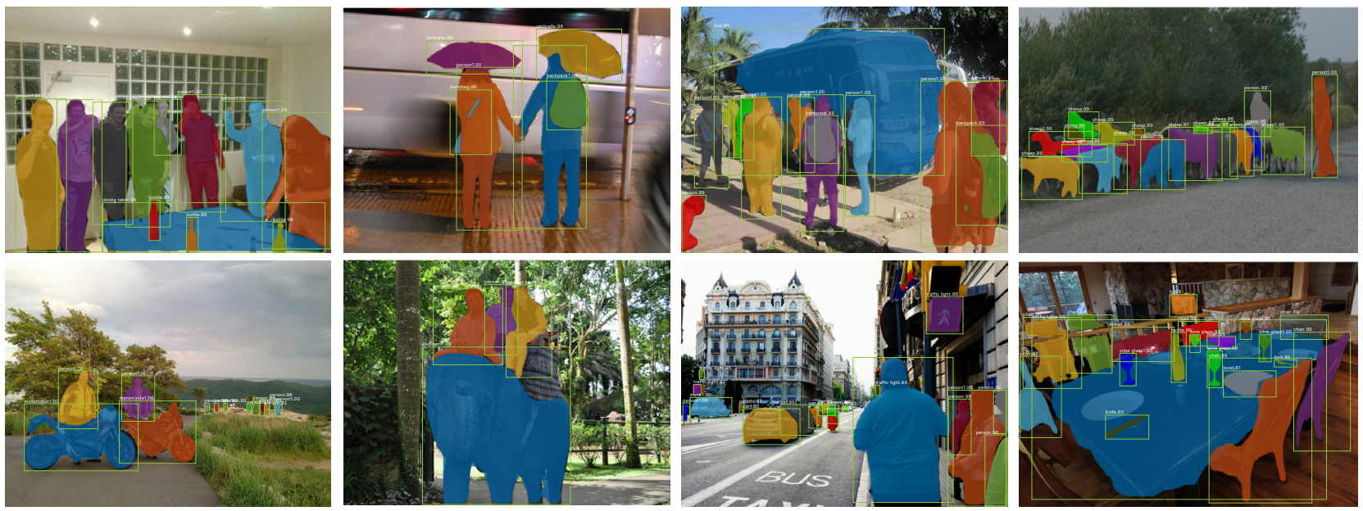
results on MS COCO data set

Slide 19
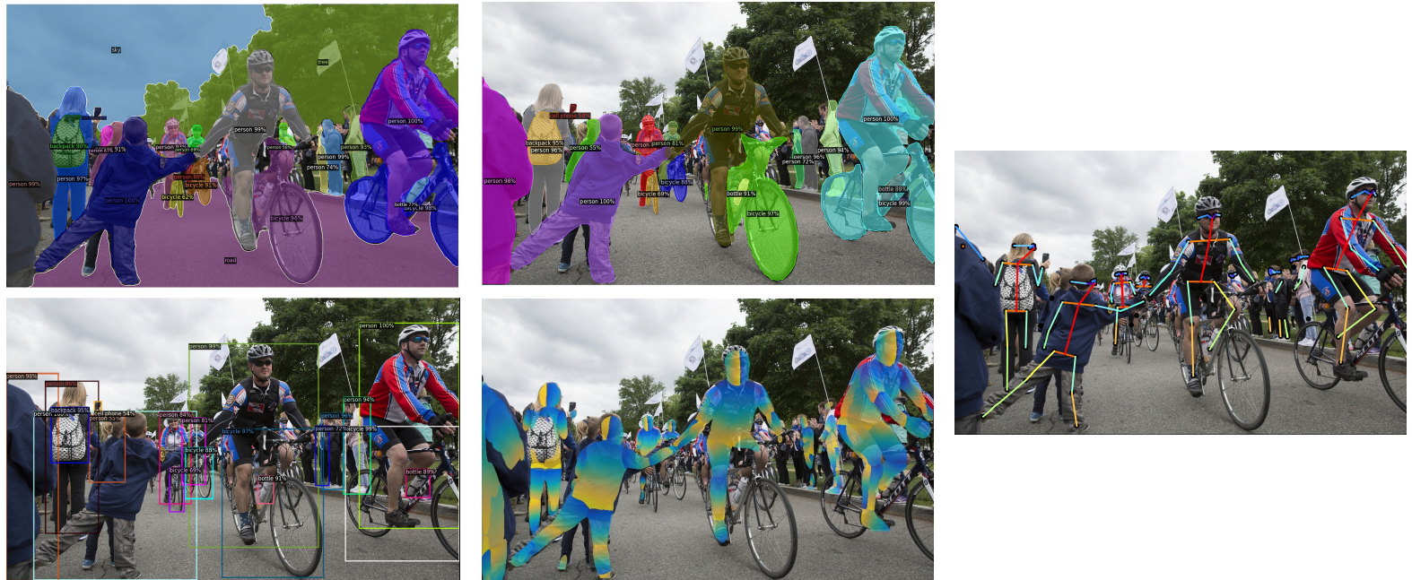
Detectron2: PyTorch Implementations

Slide 20
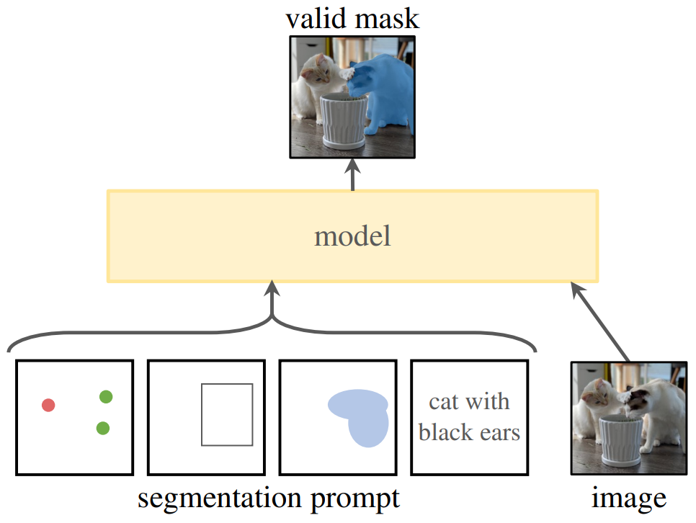
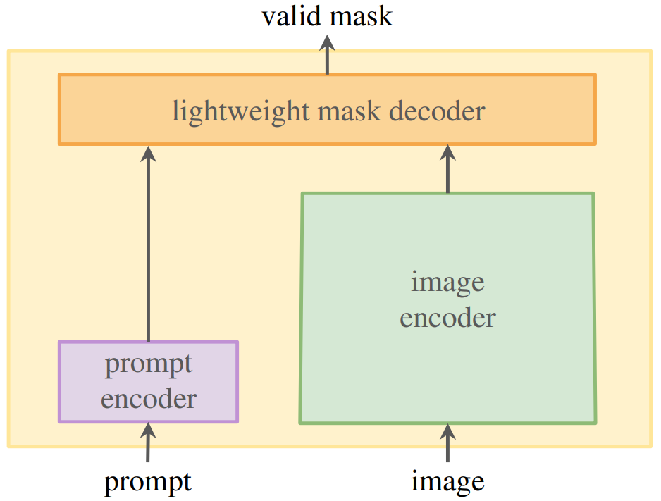
Promptable Segmentation with Transformers
Segment Anything Model (SAM)
SAM2 includes also video segmentation
transformer decoder
ViT
CLIP

